Slide 1
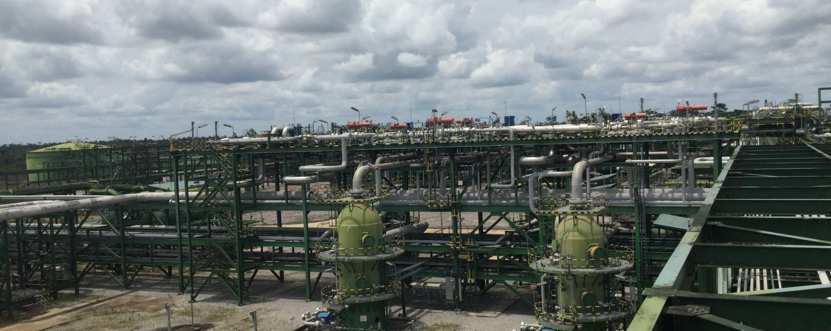
Gbaran CPF 15-Hour Outage on 20th May 2022 A Causal Learning Investigation
25th April 2022

Slide 2
Outline
Team Composition
Problem Statement
Findings
Recommendations

Slide 3
Investigation Team
Oba’ Durodola – Investigation Lead
Azibanato Etire – Investigation Facilitator
Miebi Debekeme – Co-Facilitator
Anthony Ovoh – Member (Operations)
Ebele Anyaegbu – Member (Mechanical)
Chidiebere Nkere – Member (System Engineer)
Abdul Mohammed – Member (Electrical)
Olusegun Bayowa – Member (PACO)
Blessing Ohuaka – Member (Electrical)
Otunba Gafar – Member (Operations)

Slide 4
Problem Statement
Expected
Gbaran CPF produces circa 700MMscf/d and 7,000bbls/d of condensate
Actual
Gbaran CPF was down for 15 hours on 20th May 2022
Impact
~440MMscf of gas was deferred; ~5,000bbls of condensate was deferred
Cost and GHG impact from CPF and FLB diesel generators
CCR lost air conditioning and became too hot for personnel carrying out intervention
FLB generator was started up and tripped intermittently
FLB essential services were delayed e.g. catering, laundry
Lunch was delayed by 2.5 hours and affected personnel productivity
Office buildings and accommodation blocks lost power supply
Personnel were fatigued
Planned maintenance activities were disrupted

Slide 5
Key Timeline – 20th May 2022
03:54 – Gbaran CPF tripped on OSD1 due to confirmed gas detection signal
05:25 – Gbaran CPF tripped on ESD1 due to instrument air pressure loss
05:26 – EDG automatically started
06:00 – Main instrument air compressor was re-started.
08:30 – GTGs were started
10:25 – Gbaran CPF tripped on OSD1 due to GTGs trip during switch-over from EDG to GTG and then escalated to ESD1
11:00 – GTGs were re-started and successfully switched over.
10:25 to 16:11 – Instrument air compressor troubleshoot and successful start up
17:00 – CPF plant stabilization and pressurization commenced

Slide 6
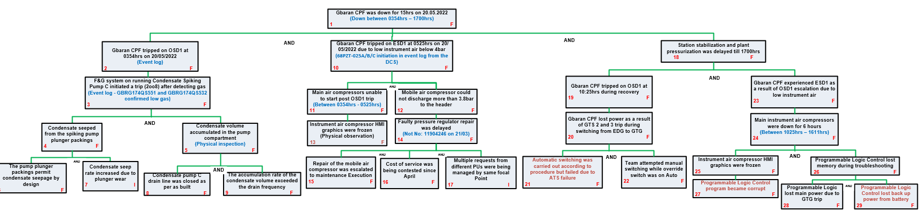
High Level Cause and Effect

Slide 7
Findings
OSD1 occurred at 0354hrs
OSD1 was initiated when gas in the condensate spiking pump area was detected by 2oo8 IRPGs, infra red point gas detectors
The condensate spiking pump plunger packings permit condensate seepage by design and condensate accumulated in the pump compartment
OSD1 shut down the instrument air compressors
ESD occurred at 0525hrs
ESD was activated when plant instrument air dropped below 4bar
Instrument air compressors startup was prevented by frozen HMI graphics
Mobile air compressor discharge pressure was below the minimum required pressure of 4bar because a faulty pressure regulating system was in use
Repair of mobile air compressor was delayed because cost challenge process was still ongoing. Ownership transition.
ESD occurred at 1025hrs
ESD was initiated when plant lost power during change over from EDG to GTG
Switching using procedure- ATS, failed. (Requires further investigation)
Personnel troubleshooting eventually found a work around (Switching requires override switch to be on manual auto mode)
Instrument air compressor startup was delayed by frozen HMI graphics because the software was corrupt, and the PLC lost main power and backup power. (Requires further investigation)

Slide 8
Recommendations
Increase Field Operator rounds to spiking pump skid (4-hourly)- Oba closed
Update switching procedure for power transfer from EDG to GTG- Abdul closed
Leaners mindset - Ownership of mobile air compressor mtce should reside with maintenance t/lead. – Jamilu/Bosini (ongoing) - 30th June
Learners mindset- Develop SOP instruction and train personnel on response to IAC HMI freeze reports including steps of program download using SAFCOE laptop and steps on checks for battery assurance - Richard (ongoing) – 15th June
Carry out a deep dive on HMI condition and invite PLC expert to support troubleshooting. Jamilu/Bosini (ongoing) – 30th June
Collaborate with process engineer to explore changing IRPG 2oo8 voting system from OSD1 to Warning Alarm and OSD3- Richard (TBD)
Investigate design intent on why OSD1 includes shutdown of instrument air compressors since OSD1 doesn’t trip GTG (Test with Process Engrg)- Richard (TBD)
Carry out a deep dive to troubleshoot failure to close R&N bus tie automatically – Abdul (TBD)

Slide 10
Findings - Timeline

Slide 11
Findings – Cause and Effect Diagram

